Slide 1
And so we begin….
Games Design Lecture 1
G.Affleck
Affl-ci0@paisley.ac.uk

Slide 2
Why bother with design?
Complex tasks are simply too difficult to think through without planning.
Prior Planning Prevents Poor Performance.

Slide 3
Modelling a system:
A representation using abstracted relevant detail while discarding irrelevant detail.
Often diagram techniques are used – Why?
Using diagramming conventions plans become easily communicable:
A picture is worth a thousand words.

Slide 4
Modelling With UML

Slide 5
What is UML?
Unified Modelling Language
Unified from:
OMT (object modelling technique)
OOSE (Object Orientated Software engineering)
BOOCH
James Rumbaugh, Ivar Jacobson, and Grady Booch
Supporting tool used on this course: Rational rose
Note: Many others exist

Slide 6
What UML features we will concentrate on:
Use case diagrams
Sequence Diagrams
Class diagrams
Statechart diagrams

Slide 7
Use case diagrams
Describe the functional behaviour of the system from user view-point.
The external initiations of internal activity.
Sequence Diagrams
Describes the dynamic behaviour between external and internal system components.

Slide 8
Class diagrams
Describe the static structure of the system.
Statechart diagrams
Describes the dynamic behaviour of an individual object.

Slide 9
We can model 80% needed with 20% UML.
I hope to cover only the most necessary parts.
Wider reading required:
Many free resources and tutorials are available on the Internet.
No real need to buy a book.

Slide 10
What are we going to model?
Let’s look at a well known and very successful game!

Slide 11
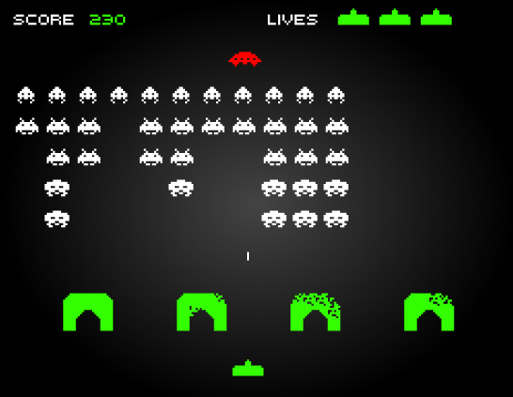

Slide 12
How would you create - What does the game consist of?
What is the first steps to modelling
Look for:
Game objects/entities/tokens
Description\Requirements
Model Behaviour

Slide 13
Looking for: Game Entities\Objects\Tokens:
No of Lives
Spacecraft
Aliens
Bullets fired by aliens
Bullets fired by defender
Bases
Defender
Screen
Score
I have simply listed everything I see on the screen (and the screen).

Slide 14
Description / Requirements list:
The Alien
Rows of aliens will descend from the top of the screen. They will move across the screen, then drop when they reach the edge of screen (left or right). The speed will increase as numbers decrease and as they get lower.
If the aliens reach the bottom of the screen, the game will end.

Slide 15
Bombs dropped by aliens
The aliens will drop random bombs. Multiple bombs can be dropped at the same time.
If a bomb hits the defender, one life is subtracted from the number of lives left.
Bomb Collision : hits a defender. hits a bullet. goes off screen.
Hits a base.

Slide 16
The Defender
The defender can move left to right at the bottom of the screen,
but cannot move off-screen.
The defender can fire bullets.
Collisions:
If a bullet hits an alien
A bullet may hit a dropped bomb
Hit a spaceships
goes off the screen.
Hits base shield

Slide 17
Base
The base consists of sections and as either bombs dropped by aliens
or bullets fired by defender hit the bases sections are blown away.
The base will lose strength as parts disintegrate and ultimately the base
will disappear.
Once destroyed the bases will not reappear with each screen.
base – Decrease strength
Hit by bomb
Hit by bullet

Slide 18
Spacecraft
At given intervals a spacecraft will appear at one side and travel to the other side. If the player hits the spaceship bonus points are awarded. If the player hits the spaceship then the next bonus points will be greater e.g. 50,100,150, 200. However when the player misses then the points will return to 50.
Spacecraft -
Trigger
Move
IsHit
No of points

Slide 19
The Defender’ Lives
The defender starts with 3 lives. At the end of each screen when all the aliens are killed the screen will reset and and the no of live is increased by 1.
If the defender is killed the player will lose one life and the game will continue.
If the defender has no lives left , the game will end.
No of lives will simply increase/ decrease

Slide 20
Score –
Increase as aliens are killed and as spaceships are hit.
Score and Lives: Player/Defender attributes?

Slide 21
Modelling Behaviour UML Use Case Diagrams

Slide 22
According to the UML specification a Use-Case diagram is:
“A diagram that shows the relationships among actors and use cases within a system.”

Slide 23

What is an Actor ?
The actor is the external initiator of internal activity.
An actor is a person, organization, or external system that plays a role in one or more interactions with your game system.
An Actor is drawn as a stick man
Example actor from a game:
Player

Slide 24
A use case describes a sequence of actions that provide a measurable value to an actor.
A use case is drawn as a horizontal ellipse on a UML use case diagram.
Player
Begin New Game

Slide 25
A use case is therefore a “case of use”
Use cases are taken from the actors point of view
What use is to be made of the game system
What the game system should do
How the game system should respond

Slide 26
Identifying the Use Case Behaviours:
Requirements/Description.
What functionality is required of the game system.
Are there any external events that affect the game system e.g. time.
Does the game system store and retrieve information – what triggers?
What information does the system provide actors.

Slide 27
Example Diagrams from Space Invaders

Slide 28
Initiator
Use Cases
Player
Move
Fire

Slide 29
Use Cases
Move Aliens
Initiator
Time
Move Player’s Bullets
Drop Bombs
Move bombs
Move spaceship
Check collisions

